Slide 1
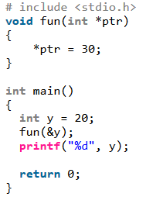
1. What is the output of following program?
A.20
B. 30
C. Compile time error
D. Run time error
Solution: B
In the statement ‘*ptr = 30’, value at address ptr is changed to 30. The address operator & is used to get the address of a variable of any data type. In the function call statement ‘fun(&y)’, address of y is passed so that y can be modified using its address.

Slide 2
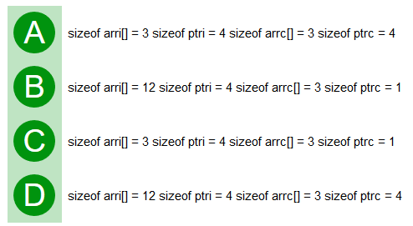
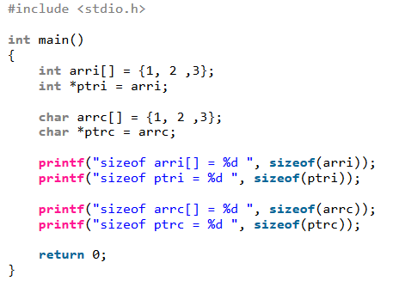
2. Consider a compiler where int takes 4 bytes, char takes 1 byte and pointer takes 4 bytes.
Solution: D Size of an array is number of elements multiplied by the type of element, that is why we get sizeof arri as 12 and sizeof arrc as 3. Size of a pointer is fixed for a compiler. All pointer types take same number of bytes for a compiler. That is why we get 4 for both ptri and ptrc.

Slide 3
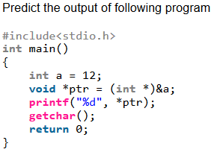
3.
A. 12
B. Compile time error
C. Run time error
D. 0
Solution: B
There is compiler error in line "printf("%d", *ptr);". void * type pointers cannot be de-referenced. We must type cast them before de-referencing. The following program works fine and prints 12.
int main()
{
int a = 12;
void *ptr = (int *)&a;
printf("%d", *(int *)ptr);
getchar();
return 0;
}

Slide 4
4. Choose a correct statement about C language arrays.
A) An array address is the address of first element of array itself.
B) An array size must be declared if not initialized immediately.
C) Array size is the sum of sizes of all elements of the array.
D) All the above
Solution: D

Slide 5
5. What are the Types of Arrays?
int, long, float, double
struct, enum
Char
All the above
Solution: D

Slide 6
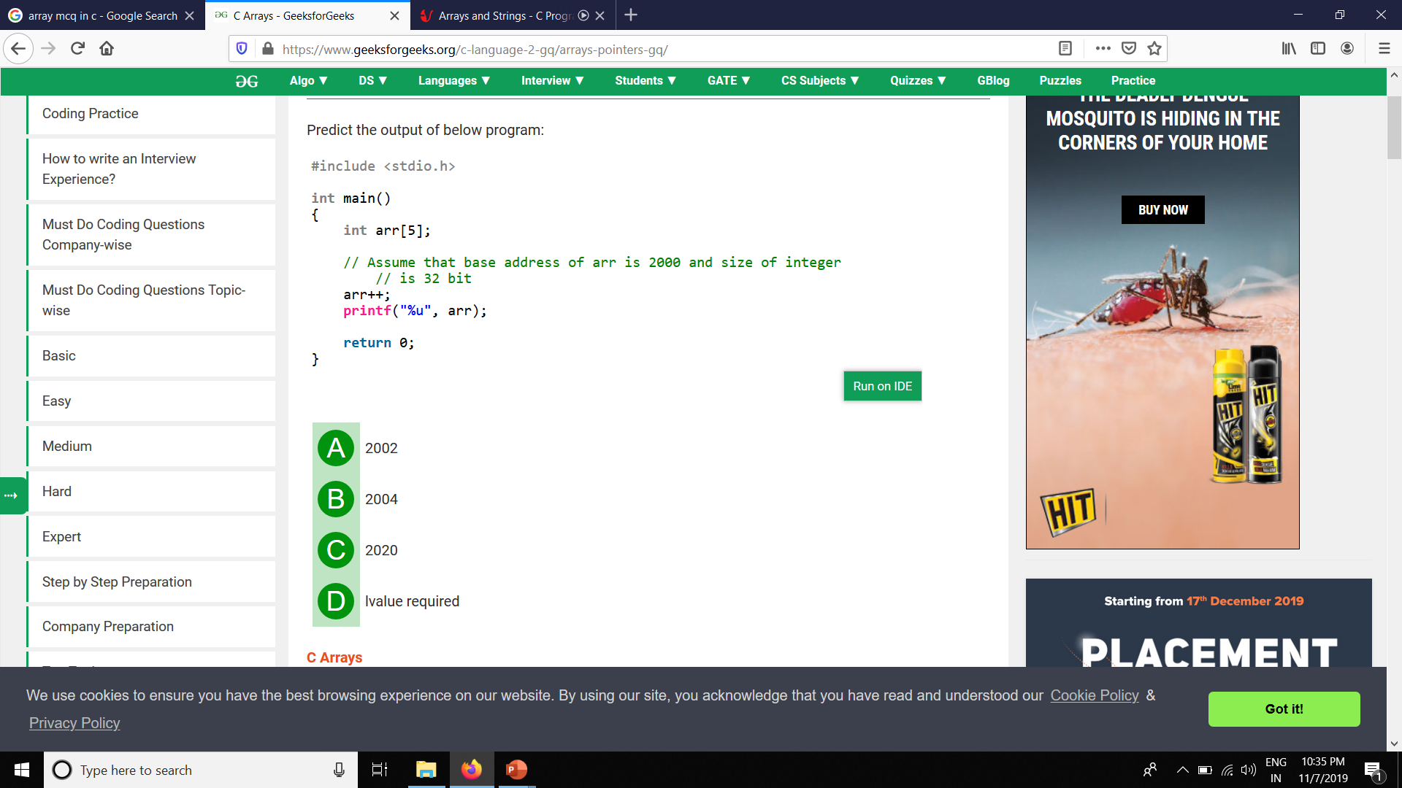
6.
A. | 2002
B. | 2004
C. | 2020
D. | lvalue required
Solution: D
Array name in C is implemented by a constant pointer. It is not possible to apply increment and decrement on constant types.

Slide 7
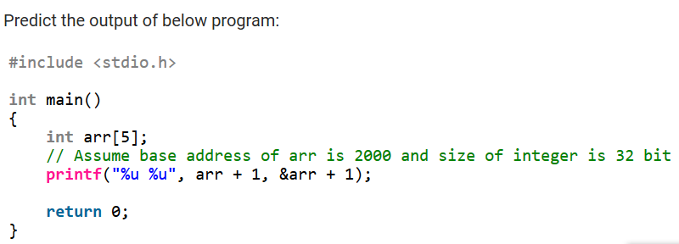
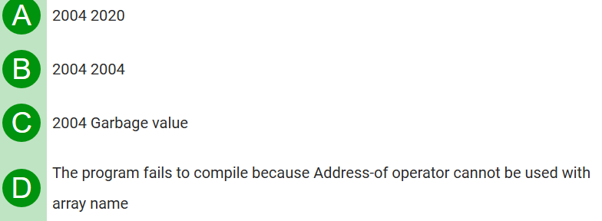
7.
Solution: A
Name of array in C gives the address(except in sizeof operator) of the first element. Adding 1 to this address gives the address plus the sizeof type the array has. Applying the Address-of operator before the array name gives the address of the whole array. Adding 1 to this address gives the address plus the sizeof whole array.

Slide 8
8. Which of the following is true about arrays in C ?
A. | For every type T, there can be an array of T.
B. | For every type T except void and function type, there can be an array of T.
C. | When an array is passed to a function, C compiler creates a copy of array.
D. | 2D arrays are stored in column major form
Solution: B

Slide 9
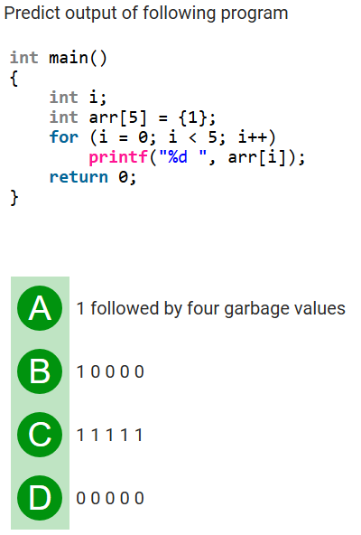
9.
Solution: B
if we initialize an array with fewer members, all remaining members are automatically initialized as 0. For example, the following statement initializes an array of size 1000 with values as 0.
int arr[1000] = {0};

Slide 10
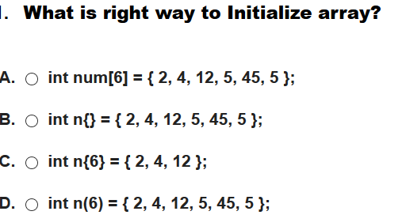
10.
Solution: A
option (B), (C) and (D) are incorrect because array declaration syntax is wrong. Only square brackets([]) must be used for declaring an array.

Slide 11
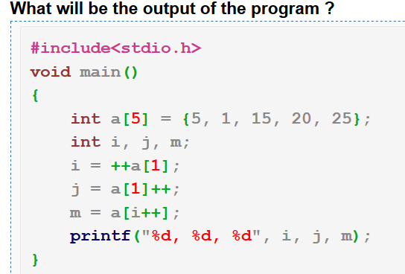
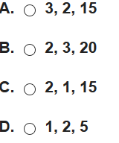
11.
Solution: A
int a[5] = {5, 1, 15, 20, 25}; The variable arr is declared as an integer array with a size of 5 and it is initialized to
a[0] = 5, a[1] = 1, a[2] = 15, a[3] = 20, a[4] = 25.
>> int i, j, m; The variable i, j, m are declared as an integer type.
>> i = ++a[1]; becomes i = ++1; Hence i = 2 and a[1] = 2
>> j = a[1]++; becomes j = 2++; Hence j = 2 and a[1] = 3.
>> m = a[i++]; becomes m = a[2]; Hence m = 15 and i is incremented by 1(i++ means 2++ so i=3)
>> printf("%d, %d, %d", i, j, m); It prints the value of the variables i, j, m
Hence the output of the program is 3, 2, 15.

